Slide 1







Slide 2
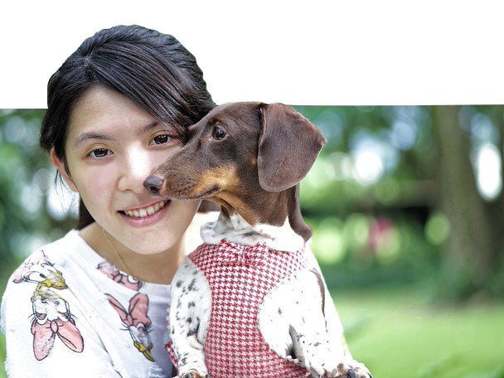


Scenario
Annie Johnson had ordered business cards for a tradeshow event to promote her pet clothing business and give discounts to future customers. Unfortunately, her order did not arrive on time and in the end, she doesn’t want the order from us anymore and would want to get a refund.
You check the system and indeed see we’re past delivery due date. What do you do?

Slide 3
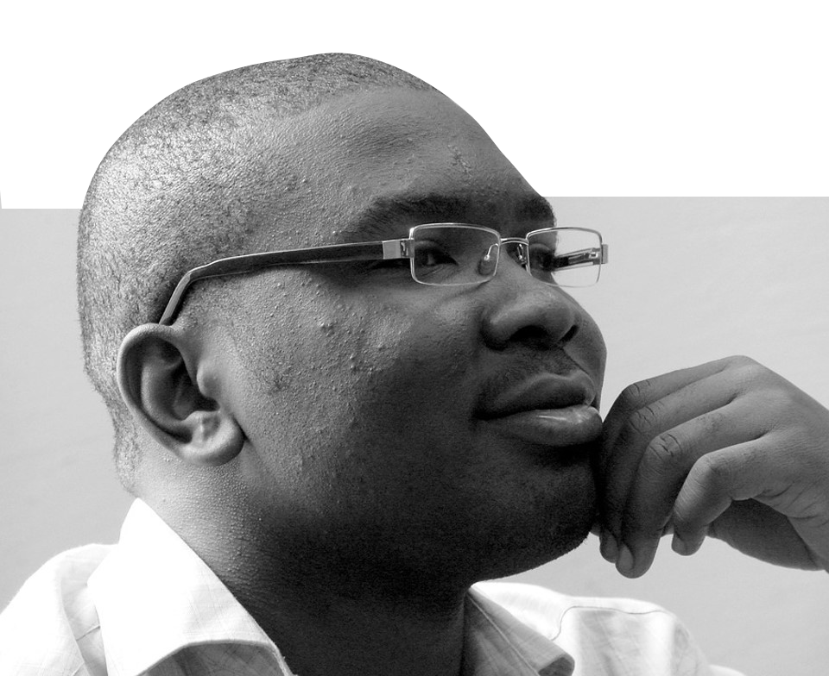


Scenario
Henry tried to make a flyer on the Vistaprint website last night, but then the largest size of the product could not fit all the words and images he would want in the design.
What could you do to help Henry with his problem?

Slide 4
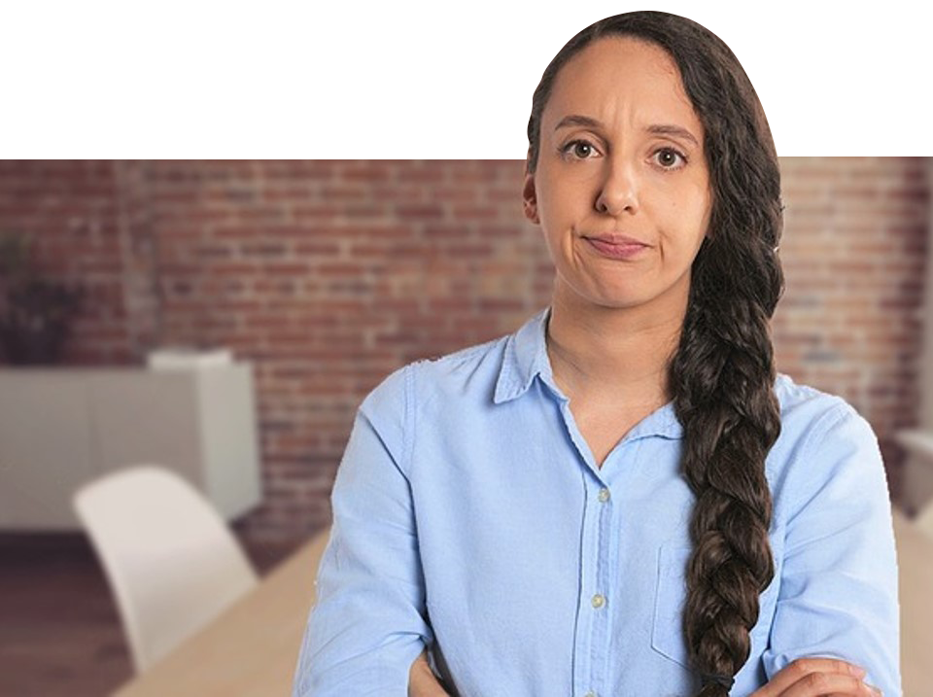

Scenario
Kelsey Becker wanted to receive her order of postcards with a delivery speed of 5 working days and insists that that was the shipping speed she paid for when she ordered 2 days ago. However, you checked the system and saw that the delivery speed chosen was “Economy”, the slower option.
What do you do?

Slide 5


Scenario
Courtney wants to add a picture on her existing design however, she is worried that the final design will get blurry since the file format of the additional picture is .GIF.
What can you tell Courtney to ensure her that her order won’t come out blurry?

Slide 6
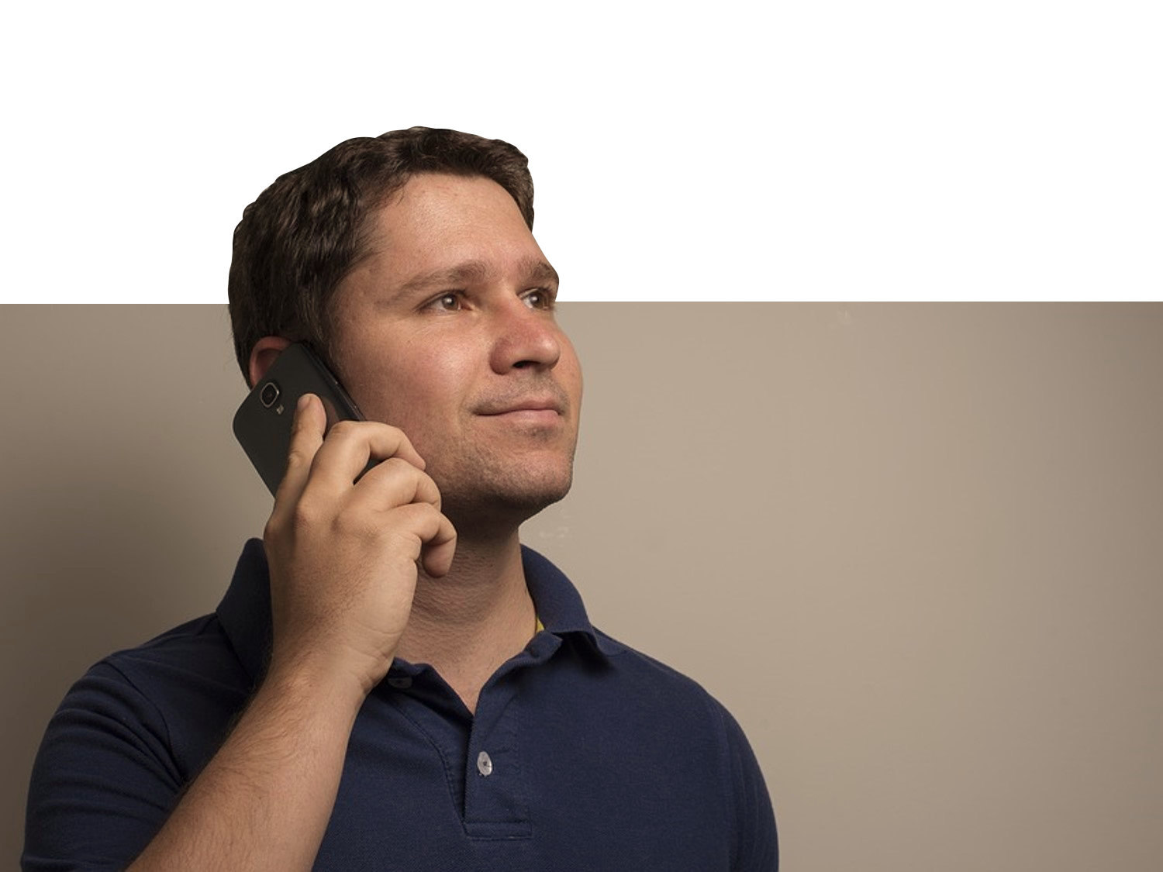

Scenario
Andrew wants to use an image that has a watermark on it and is curious if he could.
What do you tell Andrew?

Slide 7
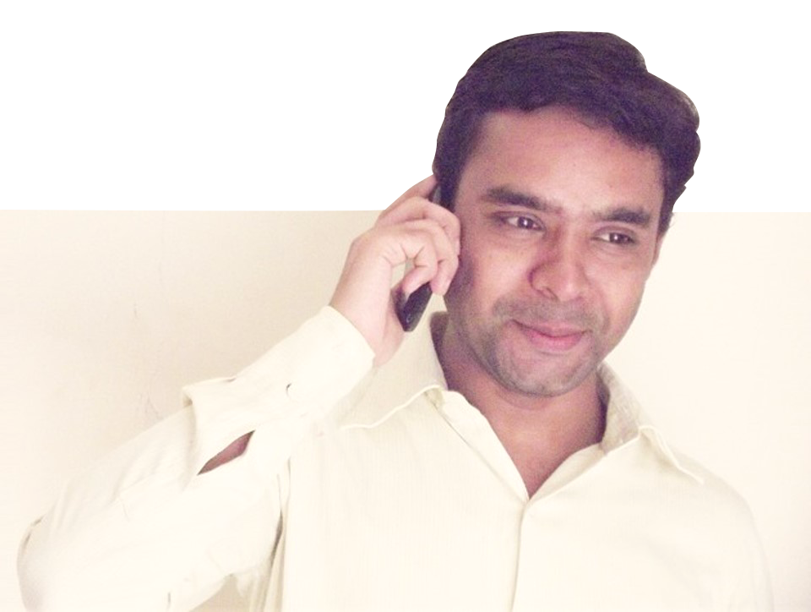

Scenario
Kevin Marco is calling to inquire about our Design Services.
What do you tell him?

Slide 8


Scenario
Kimberly wants to know the difference between CMYK and RGB.
What do you tell Rihanna?

Slide 9


Scenario
Kathy has just received her order of Letterheads. However, she noticed that the product was cut wrong and her design was everywhere on the product. Looking on our website, the design seems to be fine.
What do you do to help Kathy?

Slide 10
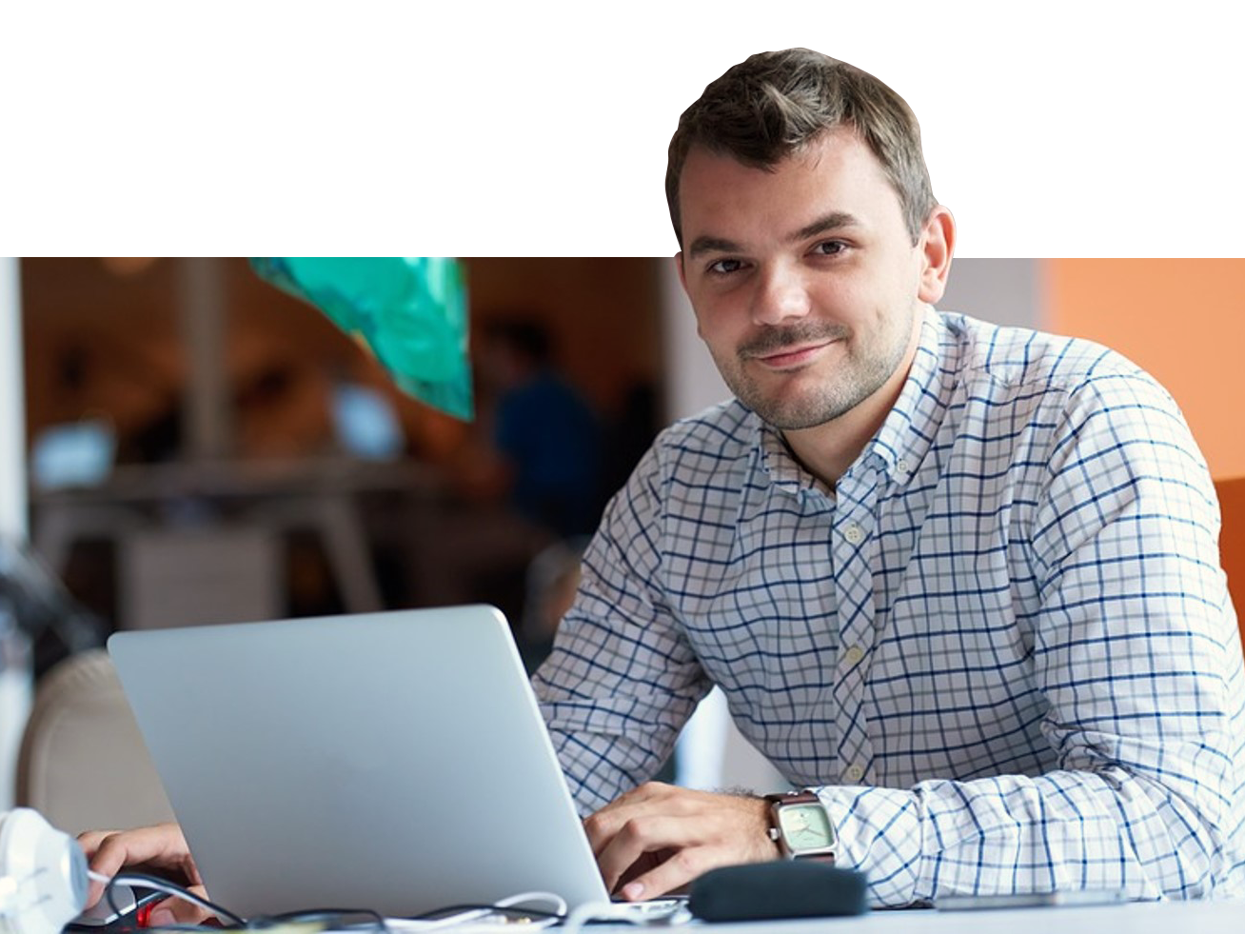

Scenario
Derrick Conrad is satisfied with your assistance in helping him design his brochure. But now, he insists in getting your private number/email so that he could contact you if ever he needed more help with his other products.
What do you do?

Slide 11
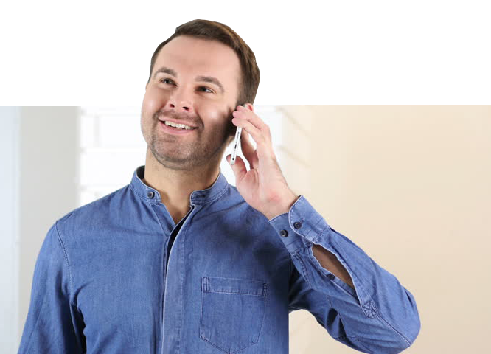

Scenario
Jay Lambert is asking if he can pick-up his order at the nearest Vistaprint manufacturing plant since he lives nearby.
What do you do?

Slide 12
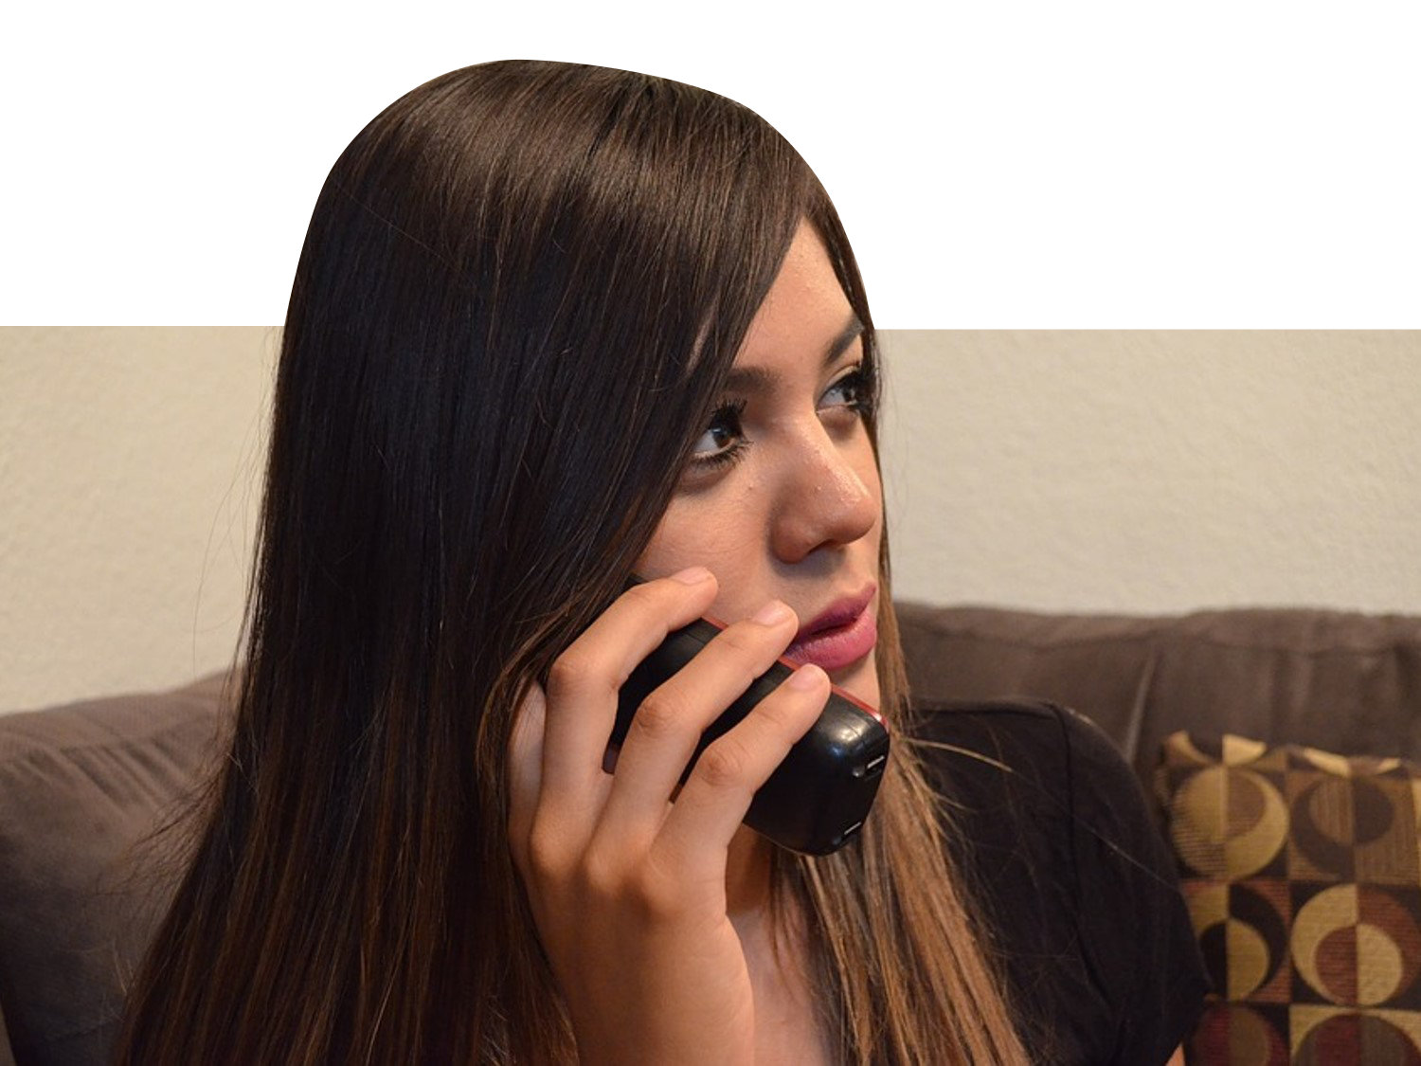

Scenario
Renee Adams is dissatisfied with the paper used on her flyer and wants to talk to our main office by requesting for their number.
What do you do?

